Slide 1
Computer Principles for Programmers
Clients, Servers, Networks, and Clouds

Slide 2
Quiz

Slide 3
News of the Week

Slide 4
Agenda
Lecture:
Computer Networks
Cloud Computing
networking and distributed computing
types of Cloud Computing: IaaS, PaaS, and SaaS.
Clients, Servers, and Tiers
File Sharing: current issues.

Slide 5
Agenda (Cont’d)
Activity:
An activity to use Office 365 as a service that offers cloud based business collaboration tools.
Is entertainment (music & video) a product or a service? There are many different ways to deliver entertainment content. Does the delivery medium change our relationship to the content? Is the medium really the message?
Notes:
Microsoft Office 365 is a combined application provided by Microsoft consisting of Microsoft Office Online (for Windows and OS X), Exchange (email), SharePoint (file sharing & collaboration), storage space on OneDrive, and a number of real-time collaboration tools. Everyone at Seneca has access to Office 365.

Slide 6

Computer Networks?
Network: a set of computers connected together for the purpose of sharing resources.
Internet: a network of peer networks.
Notes:
A computer network is “a set of computers connected together” for the purpose of “sharing resources.”
The most common resource shared today is the “Internet” which is a network of peer networks.
The picture is a small look at the backbone of the Internet. Each line represents two IP addresses, length of lines = delay between those addresses. Lines are color-coded by groups of top level domain (TLD) -- Dark blue: net, ca, us; Green: com, org; Red: mil, gov, edu, other colours for different geographic groups of countries.
Internet http://www.nickh.org/computer/glossary.html#I
The most effective productivity destroyer in business today.
Designed originally as a way for geeks to communicate with each other,
it was later found that geeks were barely able to communicate,
so it was opened up for the general public.

Slide 7
What do we mean by Computer Networks?
A computer network is a set of computers connected together for the purpose of sharing resources.
Intranet (intra = inside your private network), shared resources include print, file, DB, and web servers.
The Internet is a network of networks sharing a vast range of information resources and services.

Slide 8
Success of the Internet
TCP/IP (1982) became the standard networking protocol
HTTP, HTML, and WWW browser, then Mosaic/Netscape
Sir Tim Berners-Lee, 1990. Marc Andreessen, 1993.
Open Source: GNU/Linux 1991, Apache HTTP Server 1995
World-wide, high-speed connection, Peering shares traffic
Affordable high bandwidth (speed and capacity)
Decentralized, highly cooperative infrastructure Growth by cooperation. Innovation by competition.
Net neutrality: all packets are created equal
Notes:
Television was the internet of the 1960s, the telephone before that, and radio before that in the early 20th C. The telegraph (19th C) and newspapers (16th C) were the internet before radio. Like the internet, they were all methods of moving information around the globe and making it accessible to people. Snail mail was delivered and picked up TWELVE TIMES A DAY in 1889 London, England; it was better than your own personal FedEx.
The US Defense Department ’s ARPANET project in the 1960s of a packet switched network led to the development of protocols for inter-networking, in which multiple separate networks could be joined into a network of networks. In 1982, the Internet protocol suite (TCP/IP) was introduced as the standard networking protocol on the ARPANET which later grew into the Internet as we know it.
Berners-Lee made HTTP and WWW freely available; he has fought to keep it open, non-proprietary, and free. See https://www.wired.com/2012/02/tim-berners-lee-patent/ "The reason the Web took off is not because it was a magic idea, but because I [Tim Berners-Lee] persuaded everyone to use HTML and HTTP." And because it was open, non-proprietary, and free.
The first web page is found at http://info.cern.ch/hypertext/WWW/TheProject.html https://www.wired.co.uk/article/first-web-page
The invention of HTTP Hypertext Transfer Protocol and the textual browser in 1990 by Berners-Lee called “WorldWideWeb” and Marc Andreessen’s visual GUI Mosaic three years later (→ Netscape → Mozilla → Firefox)
made the Internet easy to use and accessible to the average person (multi-media in a single window and multiple protocols like HTTP, FTP, Usenet) and sparked growing demand for connectivity in the mid and late 1990s.
The Mosaic/Netscape browser software was FREE for non-commercial use. Building a business by giving stuff away was a revolutionary model.
https://www.internetsociety.org/internet/
https://www.inverse.com/article/14959-celebrating-23-years-of-the-www-how-tim-berners-lee-open-sourced-the-internet
https://home.cern/cern-people/opinion/2013/04/twenty-years-free-and-open-www
https://opensource.com/life/14/4/25-years-world-wide-web
https://webfoundation.org/about/vision/history-of-the-web/
https://www.theguardian.com/technology/2017/mar/11/tim-berners-lee-web-inventor-save-internet
https://www.vanityfair.com/news/2018/07/the-man-who-created-the-world-wide-web-has-some-regrets
http://yourlifesolution.com/7/the-man-who-would-have-been-a-trillionaire/
In the 1990s, UNIX was dying in the small to medium sized business world with the rise of Microsoft Server. All the IT trade press was predicting the demise of UNIX. In the early 1990s, IBM and Microsoft ignored the Internet as a poor public substitute for high quality private telecommunication networks. If you wanted a web server, you had to make one. Only the UNIX OS was open enough for anyone to develop applications like a web server on affordable micro hardware and deployable on mini hardware (mid-size servers) powerful enough to do the job. Both IBM and Microsoft’s servers were too closed at the time for this type of development. Researchers and innovators accepted the TCP/IP standard and embraced the idea of a network of independent networks and non-proprietary servers.
World-wide communications: During the dot-com bubble, the days of the “information superhighway”, a large number of telephone companies, known as “telecoms”, built optical fibre networks. Telecoms were in a greed-fueled race to corner the market in telecommunications by providing a network with sufficient capacity to take all existing and forecast voice and data traffic for their entire region served. This was based on the assumption that telecom traffic, particularly data traffic, would continue to grow exponentially for the foreseeable future…and that each telecom would get their “fair share” of the market, their fair share being 100%. (Tim McKenna was at a New Years Eve party in 2001 where a “golf-pro” who was just recently a senior VP in a telecom firm, admitted that for all the sales forecasts to come true, North America would have needed well over a billion extra residents to soak up the capacity on offer.) There was willful ignorance of demographics and blindness to the limits of exponential growth. (See S curve, Logistic function, http://www.slideshare.net/wright4/double-scurve-model-of-growth)
Affordable High bandwidth: The capacity of commercial lightwave systems increased from less than 100 Mb/s when they debuted in the 1970s to roughly 1 Tb/s by 2000. This is an increase of more than 10 000 times in 30 years, but more incredibly, the introduction of WDM wavelength-division multiplexing during the latter part of the 1990s resulted in a factor of 1000 increase in just 10 years. This dramatically reduced the demand for physical fibre by increasing the capacity that could be placed on a single fibre by a factor of as much as 100 during the dot-com bubble. In the late 1990s through 2000, the telecoms saw the market opportunity of data traffic's estimated growth rates "doubling every 100 days" which was optimistic. But they did not take into account the capacity to carry that traffic was doubling every six months starting in 1992 until a bit rate of 10 Tb/s was reached by 2001. Optical communications underwent a revolution in the 1990s as optical amplifiers and WDM enabled the information carried on a single fiber to move from a few gigabits per second to over one terabit per second. As a result, the wholesale price of data traffic collapsed (what your business plan expected you could sell for a $1 was now going for a penny) and with it, the rest of the telecoms’ shaky economic assumptions (Yesterday's needs will be solved by Today's technology; despite Today's solution, Yesterday's needs will continue Tomorrow and Tomorrow will never have a better solution than Today's). (Proceedings of the IEEE, Volume: 100 Issue: 5. Capacity Trends and Limits of Optical Communication Networks, 2012. https://doi.org/10.1109/JPROC.2012.2182970 ) https://en.wikipedia.org/wiki/Fiber-optic_communication#History
The result of the greed was a lot of unlit fibre, known as "dark fibre". Dark fibre is now used for dedicated connections between a company and cloud or network services. Ironically, IBM and Microsoft's limited vision of private and secure telecom networks was satisfied by the growth of the public, insecure Internet. And made very inexpensive.
Higher bandwidth created new opportunities. It wasn’t just data and files going over a network, it became pictures, music, and video that could be streamed.
decentralized : No one is the “boss” of the Internet, no one company owns it. The Internet backbone is a conglomeration of multiple, redundant networks owned by numerous companies. Massive cooperative infrastructure of fibre cables in the ground and under the ocean, many core router nodes (Internet exchange points, IX or IXP) in all major cities with between 1 and 5.6 tera-bits per second capacity. https://en.wikipedia.org/wiki/List_of_Internet_exchange_points_by_size
Growth occurred because of cooperation, innovation because of competition. It was a healthy balance.
The Internet is a collection of separate and distinct networks, each one operating under a common framework of globally unique IP addressing and global routing (each network exchanges routing and reachability information for all other networks). Peering involves two networks coming together to exchange traffic with each other freely, and for mutual benefit. This 'mutual benefit' is often "reduced costs for transit services". neither party pays the other in association with the exchange of traffic; instead, each derives and retains revenue from its own customers within its own network. https://en.wikipedia.org/wiki/Peering
In only ~25 years, the Internet has grown to be considered a public utility like electricity and water, computers are almost useless without network connectivity. The Internet, i.e. communication, is also considered essential to supporting human rights. Soon, it may be considered a human right in and of itself. In Summer of 2016, the United Nations Human Rights Council released a a non-binding resolution condemning intentional disruption of internet access by governments. The resolution reaffirmed that "the same rights people have offline must also be protected online.“ https://en.wikipedia.org/wiki/Right_to_Internet_access#2016:_UN_Resolution
Net neutrality is the principle that Internet service providers and governments regulating the Internet should treat all data on the Internet the same, not discriminating or charging differentially by user, content, website, platform, application, type of attached equipment, or mode of communication
Business model: peering (cooperative, no charge for exchanging traffic) and transit (competitive, chargeable)
Peering involves two networks coming together to exchange traffic with each other freely, and for mutual benefit. This 'mutual benefit' is often "reduced costs for transit services". neither party pays the other in association with the exchange of traffic; instead, each derives and retains revenue from its own customers within its own network. https://en.wikipedia.org/wiki/Peering
https://en.wikipedia.org/wiki/Tier_1_network
Tier 1 networks (e.g. Amanah in Toronto), which can reach any other network on the Internet, are all peering networks, i.e. "transit free"; Tier 1 networks do not charge other Tier 1s for TCP/IP traffic. But they do charge Tier 2 networks for "transit".
Tier 2 networks (e.g. Toronto Internet Exchange Community–TorIX–https://www.torix.ca/– one of the largest internet exchanges in the world, TorIX members freely exchange each other's traffic) pay Tier 1s for transit to other networks, and charge transit from Tier 3 networks.
Amanah and TorIX (and Coligix and Neutral Data Centres and others) are located in Canada's premier International Telecom Carrier Hotel and Data Center at 151 Front St. West in Toronto (and also at 45 Parliament Street). It is the safest building in the city and the most connected telecom facility in the country with 25 diverse fibre-optic points of entry into the building. It utilizes the latest technologies in advanced direct power feeds, deep water cooling systems, rooftop generators, fire safety, and high-tech security surveillance. See https://www.theglobeandmail.com/report-on-business/a-telecom-nerve-centre-to-a-nation/article560097/
Tier 3 Internet Service Providers (ISPs) initially charged only for connection, not usage. like the telephone, you can talk all you want once you have a connected phone. In the early days, data usage was not metered. Data consumption was limited by slow connections. As connections got faster, applications, web sites, and file sharing became data hungry. Then the tragedy of the commons happened: data was free! so everyone just left the lights on and the taps running. Higher speeds turned into less throughput as bandwidth became saturated. Data consumption came to be metered at the customer level to provide balance and fairness in the overall system or to bilk your bank account depending on your ISP. More recently, with improvements to networks and especially to the last mile (fibre to the premises), data caps are coming off. (Big ISPs hope to control that by getting rid of net neutrality.)
A peering relationship is one by which you and another entity exchange traffic for each others' customers, and no one else. (between Tier 1 Internet Exchange Points and within a Tier 2 Internet Exchange Point) When a provider bears traffic for you that is not destined for their customers, you are paying for transit from them. (between Tier 2 IXPx and all Tier 3 networks)

Slide 9
The Internet is brought to you by…
Browsers (Firefox, Chrome) parse and organize Internet content into a consumable form for end users
Search engines (Google, Bing) help you discover online content
Content creators author the content you see online. (Human beings who need to eat just like you do.)
Platforms (Facebook, Shopify, Wordpress, Drupal, LAMP, ASP.NET) where the content is published
Hosts (matrix, Amazon Web Services, WHC.ca, Rackspace) provide infrastructure where the platforms live
Internet Service Providers (ISPs) (Teksavvy, Bell, Rogers) connecting end users to the Internet (Tier 3)
Transit Providers connect you from the last mile (Tier3 ISPs, Tier 2) to the rest of the Internet (Tier 2 & 1)
Reverse Proxy/CDN^{[1]} (Akamai, Cloudflare) provide networks to cache content and protect from attack
Recursive DNS^{[2]} providers (OpenDNS, Google) cache info to resolve end users' DNS queries quickly
Authoritative & Root DNS (Dyn, Cloudflare) official reference of domains, names, and related IP addresses
Registrars (Tucows) registers domain names. ICANN^{[3]} governs internationally. https://whois.icann.org/en
Registries (cira.ca, Verisign) administer top level domains (TLD) .ca, .com IANA & RIR^{[4]} govern the TLDs
[1] CDN = Content Delivery Network distributes traffic better than a single server and protects from DDoS attack
[2] DNS = Domain Name System/Services translates human usable domain names into IP addresses
[3] ICANN = Internet Corporation for Assigned Names and Numbers sets rules for Registrars and Registries
[4] IANA = Internet Assigned Numbers Authority & RIR = Regional Internet Registries provide IP addresses used by Registries and Registrars.
Notes:
Yes, this slide has way too much info on it, done just to emphasize the many "moving parts" it takes to make the internet work.
It's not on the quiz.
DNS = Domain Name System/Services
The Internet Corporation for Assigned Names and Numbers (ICANN) governs protocol parameters, Internet number resources (IP addresses) and domain names (through IANA) on behalf of the global Internet community.
https://www.icann.org
https://www.apnic.net/about-apnic/organization/history-of-apnic/history-of-the-regional-internet-registries/
Speed, Security, and Safety Through DNS.
https://umbrella.cisco.com/blog/2013/12/11/speed-security-safety-dns/
What Is the Difference between Authoritative and Recursive DNS Nameservers?
https://umbrella.cisco.com/blog/2014/07/16/difference-authoritative-recursive-dns-nameservers/
A useful description of how the internet works is found at
https://www.eff.org/document/internet-engineers-commentsfcc-nn
https://cira.ca/blog/information-technology/infographic-%E2%80%93-dns-canada
https://www.dnsperf.com/

Slide 10
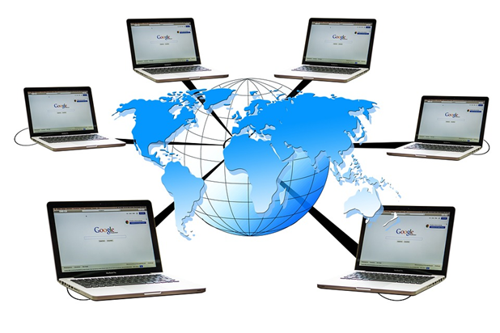
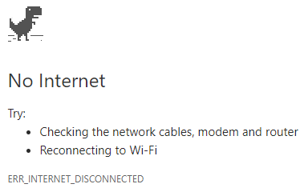
What are the issues of shared computing and networking?
How do you feel when this happens?
Notes:
"We as a society chose to get more connected, and one of the perils of doing that is, the more connected you are with everybody, the more connected you are with malicious people as well." -- Scott Culp, Manager - Microsoft Security Response Center
The Bad News
Need for security and firewalls, user IDs and passwords, Malware protection
Privacy, “would you like to share your location?”
Hacking, phishing, ransomware, spoofing, spyware, packet sniffing, worms,
Email overload and spam
BOTS, DDoS attacks, reliance on Internet as a utility or a road – you expect it to be there.
The Good News
Ordering a pizza, e-commerce, online shopping.
Wikipedia and the world-wide sharing of information. See https://wikimediafoundation.org/wiki/Home
Connecting people with common interests who would never otherwise know each other
Cheap long distance telephone rates
Wireless, i.e. Mobile communication, because the demand for easy and ubiquitous communication was so strong.
multiplayer online games and virtual reality communities,
accessible information processing systems such as banking systems and airline reservation systems that previously required a visit to a bricks & mortar location where experts used the systems on your behalf.
Uber, AirBnB – now you can know who to get a ride from or who you can stay with in another city.

Slide 11
Reddit.com 2015
"If someone from the 1950s suddenly appeared today, what would be the most difficult thing to explain to them?"
Top rated answer:
I possess a device, in my pocket, that is capable of accessing the entirety of information known to man. …
I use it to look at pictures of cats and get in arguments with strangers.
Notes:
https://as.reddit.com/r/AskReddit/comments/15yaap/if_someone_from_the_1950s_suddenly_appeared_today/
"The real revolution is small and fast and slides right into our lives so snugly that we forget what our lives were like preceding it, that we become anxious and disoriented when denied access to it."
Back then, in the 1950's, " Our imaginations knew no bounds."

Slide 12
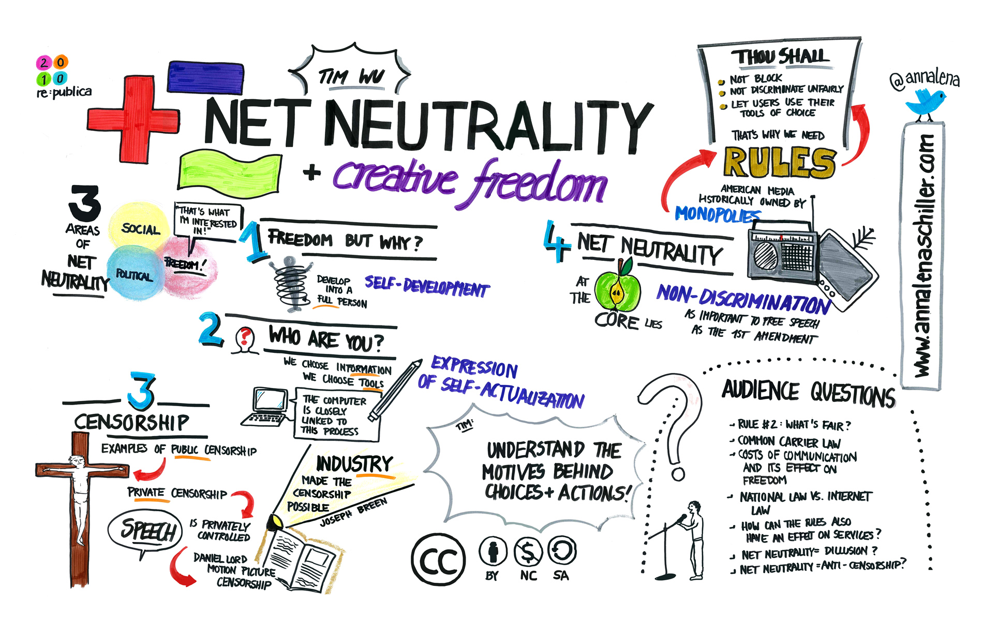
Net Neutrality (Tim Wu, 2003)
Principle of an open, neutral Internet:
Internet providers do not use their privileged position to favour some applications and services over others.
All packets are equal.
Notes:
Net Neutrality And Creative Freedom (Tim Wu at re:publica 2010) by Anna Lena Schiller (CC BY-NC-ND 2.0) https://flic.kr/p/7VfazT
https://en.wikipedia.org/wiki/Net_neutrality
http://www.michaelgeist.ca/tech-law-topics/net-neutrality/
https://spectrum.ieee.org/telecom/internet/net-neutralitys-technical-troubles
Net Neutrality's Technical Troubles
The debate has centered on policy, law, and finance, as if the network itself were a given. It is not.
What…does equal treatment mean? The Net needs to manage its diverse traffic, just as a city must manage the flow of pedestrians, bicycles, buses, delivery trucks, cars, and the occasional emergency vehicle on its streets. Any general rule must affect some kinds of traffic differently from the others, which is why you have car-friendly roads, bike lanes, and malls given over entirely to foot traffic.
Everyone who suffers from Internet traffic jams has a favorite villain. Streaming-video watchers blame carriers for throttling data flow to their phones or computers. Real-time gamers howl that delays and losses in data transmission hobble their competitive performance. This problem is so bad that Riot Games, maker of the popular League of Legends, plans to build a dedicated high-performance gaming network.
The stakes are rising with the promise of new Net applications, such as communication among autonomous vehicles. Also at stake is the future of wire-line telephone service, which FCC chairman Tom Wheeler wants to shift from aging landline networks to the Internet.
Yet so far the debate has centered on policy, law, and finance, as if the network itself were a given. It is not.
“There’s a lot of complexity here at a technical level that is absolutely lost in the policy conversations,” says Fred Baker, a distinguished engineering fellow at Cisco Systems and former chair of the Internet Engineering Task Force. Getting the technology right is crucial for the future of the Net.
The fundamental technical challenge is getting the Net to carry traffic that it was never meant to handle. Internet packet switching was designed for digital file transfers between computers, and it was later adapted for e-mail and Web pages. For these purposes the digital data does not have to be delivered at a specific rate or even in a specific order, so it can be chopped into packets that are routed over separate paths to be reassembled, in leisurely fashion, at their destinations.
By contrast, voice and video signals must come fast and in a specific sequence. Conversations become difficult if words or syllables go missing or are delayed by more than a couple of tenths of a second. Our eyes can tolerate a bit more variation in video than our ears can tolerate in voice; on the other hand, video needs much more bandwidth.
Voice and video can be converted into series of packets coded to identify their contents as requiring transmission at a regular rate. For telephony, the packet priority codes are designed to keep the conversation flowing without annoying jitter—variations in when the packets are received. Similar codes help keep video packets flowing at the proper rate.
In practice, these flow controls are not crucial in today’s fixed broadband networks, which generally have enough capacity to transmit voice and video. But mobile apps are a different story.
“Wireless has a lot of stuff moving around, so it needs much tighter management than wire line,” says a senior engineer at Nokia Networks, where he is responsible for innovation

Slide 13
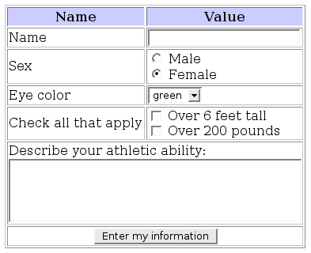
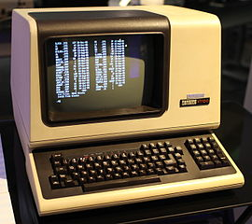
Dumb Terminals & Single-Tier Architecture One server does all thinking, processing, storing.
Thin Client HTML Form
DEC VT-100, 1978
Notes:
The DEC VT-100 (1978) established the standard for terminal connections to UNIX hosts. It was a video display implementation of old teletype terminals which input from keyboards and punched paper tape and output by printing on a roll of paper similar to a typewriter (line feeds and carriage returns). This “dumb” terminal had lots of smarts for cursor and color control making the entire 24 line by 80 column screen addressable and controllable by a program using ANSI escape codes, i.e. a sequence starting with the character ESC, ASCII decimal 27. These sequences told the terminal to underline, dim, reverse-video, or change colour using line/column coordinates, and especially to simply clear the display and position the cursor. Terminals were "dumb" because they interrupted the host computer at each keystroke. A keycode was sent from the terminal's keyboard to the host computer which recognized it send a code back to the terminal to display, for example, an "a" on the screen. This is why you can type ahead of the display…it c a n t ak e a long time fo r t hat t o hap pe n
See
https://en.wikipedia.org/wiki/Computer_terminal
https://en.wikipedia.org/wiki/VT100 and https://en.wikipedia.org/wiki/ANSI_escape_code
http://www.pcmag.com/feature/348634/the-forgotten-world-of-dumb-terminals
PuTTY is a terminal emulator you likely use to sign on to matrix. “TTY” means TeleTYpe. Go look at the Terminal features inside the PTY config, you’ll see VT-100.
IBM had "intelligent" block mode terminals which recognized their own keystrokes and exchanged formatted blocks of data with the host instead of just single characters. IBM 3270 terminals were used with mainframes and 5250 terminals were used with mid-range computers. You will program IBM 5250 terminals in the BCI433 course
Browsers and HTML Forms.
Image By File Upload Bot at the English language Wikipedia, CC BY-SA 3.0, https://commons.wikimedia.org/w/index.php?curid=9000152
Now, browsers are the “dumb” terminals and have eclipsed most traditional client-server applications although the conceptual model remains. With HTML5 and JavaScript, they can be quite smart. Early Google Chromebooks were a modern dumb terminal: it has limited CPU, RAM, and local storage (AKA Thin Client). Just like a VT-100, it doesn’t need much because the server and a fast network take care of the rest. Without a network, it isn't dumb; it's an anchor.
It is amazing how much can be done through a browser these days: Office 365, email. But functionality is limited by the browser and Javascript. Applications that require a high degree of user interaction can feel slow even over a fast network due to latency.
HTTP and the IP part of TCP/IP (.../Internet Protocol) is a stateless protocol which means that the connection between the browser and the server is lost once the web page is loaded. The server forgets about the client. The stateless design simplifies the server design because there is no need to dynamically allocate storage to deal with conversations in progress. If a client session dies in mid-transaction, no part of the system needs to be responsible for cleaning up the present state of the server. A disadvantage of statelessness is that it may be necessary to include additional information in every request, and this extra information will need to be interpreted by the server. As a work-around for the lack of a session layer in HTTP, HTTP servers implement various session management methods typically utilizing a unique identifier in a cookie or parameter that allows the server to track requests originating from the same client, and effectively creating a stateful protocol on top of HTTP. That, and a lot of smart JavaScript makes many web applications look stateful. https://en.wikipedia.org/wiki/Stateless_protocol
https://www.google.com/chromebook/
https://www.google.com/chromebook/switch/ -- OOPS! it doesn’t do Skype. Like iOS doesn’t do Flash.
https://www.cnet.com/news/the-five-stages-of-chromebook-acceptance/
https://www.atlantic.net/community/whatis/stateless-and-stateful-models-of-web-development/
https://launchschool.com/books/http/read/statefulness
https://petabridge.com/blog/stateful-web-applications/

Slide 14


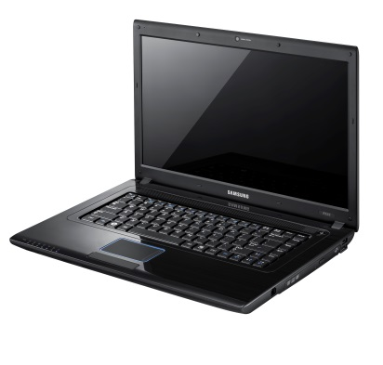

Two-Tier Architecture — Client–Server Model
User's data sets sent & retrieved
Protocol
User's Transactions submitted
Server/Host Business
centralized: multi-user processing, data store, communication with other systems
Client is User Facing
distributed: advanced presentation, user data management
Exchange ←|→ Outlook
POP, IMAP ←|→ Thunderbird Google ←|→ Chromebook
Notes:
Two-Tier: application processing is shared between server and client. Why bother with an intelligent "fat" client in this day and age? Because the network is still too slow and servers too busy to handle the UI of sophisticated applications. Functionality is not limited on the client. Applications that require a high degree of user interaction can feel as fast as the local client hardware.
A client application, usually in the form of a compiled locally installed program or "app", establishes a connection with a server. The server typically handles the database and performs business-side functions. The client takes care of the user interface; it handles the selection and presentation of data records (sorting, filtering, calculations), validates user input, and commits a transaction to the server. CRUD (eventually) happens on the Server and is reflected on the Client: Create, Read, Update, and Delete records in a database.
Smart clients can also contribute to fault tolerance by buffering and storing transactions when a connection with the server is interrupted, load balancing is the client doing the work of presentation and validation locally. Security can be enhanced by using proprietary protocols between client and server and by maintaining “stateful” connections. A stateful connection is two systems remaining connected, either can talk to the other, both remember the state (who is signed on, data, multi-stage transactions in progress), the connection is kept open even though the two systems might not be transmitting information (i.e., the connection itself retains state), the connection ends deliberately with a sign off process. A telephone call between two people is a stateful connection.
An application has its own compiled client program which serves as its user interface and had to be separately installed on each user's personal computer. An upgrade to the server-side code of the application would typically also require an upgrade to the client-side code installed on each user workstation, adding to the support cost. In addition, both the client and server components of the application were usually tightly bound to a particular computer architecture and operating system and porting them to others was expensive. (Today, native apps for mobile devices can be hobbled by some or all of the foregoing issues.)
See https://en.wikipedia.org/wiki/Web_application#History

Slide 15
FTP is a Client–Server application
1. Client authenticates and makes a connection
2. Client navigates to directories on both sides
3. Client requests, Server sends or accepts file
Client
Server/Hostr
4. Client (or Server) sends confirmation message to Server (or Client)
Notes:
FTP, File Transfer Protocol, is a simple client – server application. The protocol allows diverse server and client software to work with each other.
After signing on, the client program navigates to the server side directory and its own client side directory.
Clients sends commands to get or put a file or list a directory – usually through a GUI interface where actual FTP commands are interpreted from click and drag mouse movements.
Two very separate client and server programs are needed to insulate each other from diverse operating systems and to allow securely authorized access to each other's file systems.
IPC144 students do this when transferring their C source code to matrix.
Notes for ICT people using FTP with command line or GUIs can be found at
http://inside.senecacollege.ca/mylearning/ICT , Learning FTP
https://www.lynda.com/FTP-tutorials/Welcome/189068/364887-4.html?org=senecacollege.calege.ca

Slide 16
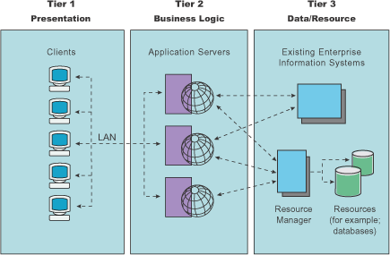
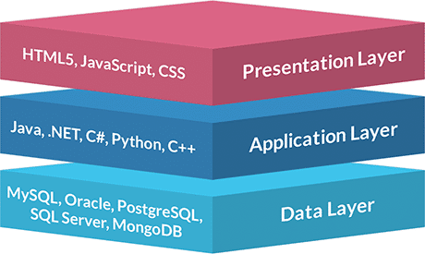
Three-Tier or N-Tier Architecture
Notes:
In Software Development, it is known as the MVC, Model – View – Controller, architecture
3-Tier Architecture was invented to avoid many problems and issues with 2-Tier, Client-Server business applications…where presentation and business application logic were in a resident client program with primarily data storage & database on the server side.
In overall systems development, 3-Tier Architecture is divided into 3 layers:
Presentation Layer at Client (VIEW)
- User interface, input validation (values and simple rules based), calculations where data can easily be buffered on the client, graphics, charts, and non-textual display, device specific presentation (PCs with big screens down to smartphones) and overall User Experience. E.g. presents a table of data with calculated values which user can filter and sort without any Tier 2 or 3 interaction.
- Tier 1 is similar to the Thin Clients of Single-Tier architecture. Single-Tier and Three-Tier can seem very much the same from the user's POV. Users should not care or be aware of how many tiers or servers are involved at the other end.
Functionality Layer at Application Server (CONTROLLER)
- "thinking" and decision making occur here
- Business rules, application logic, input validation (data based, integrity checks, authority rules), data insertion/modification, complex calculations with inputs from many sources.
- Simple example: web with PHP server
Data Layer at Database Server (MODEL)
- Data repository, load balancing, redundancy | fail-over, backup.
- MySQL supporting PHP in Tier 2.
Three layer graphic from https://www.jinfonet.com/wp-content/uploads/2018/08/3-tier_architecture-460x275.png
Tier 1, 2, 3 graphic from https://www.ibm.com/support/knowledgecenter/en/SS7JFU_8.5.5/com.ibm.websphere.express.doc/ae/covr_3-tier.html

Slide 17
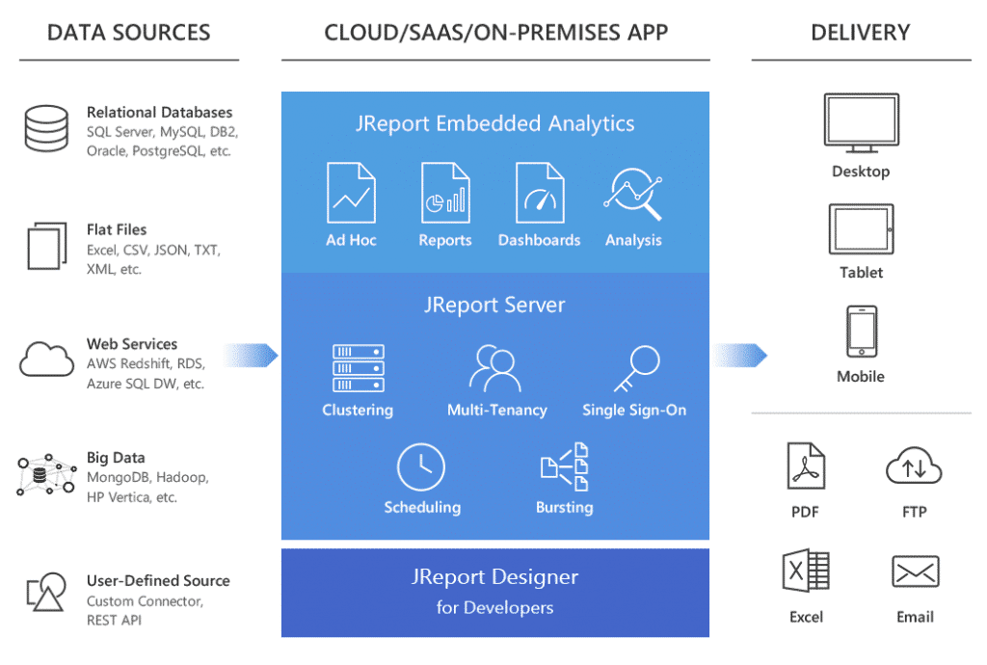
Notes:
An example of why Three-Tier is used.
https://www.jinfonet.com/wp-content/uploads/2017/12/3-tier-architecture-jreport-1-1024x690.png
https://www.jinfonet.com/resources/bi-defined/3-tier-architecture-complete-overview/

Slide 18
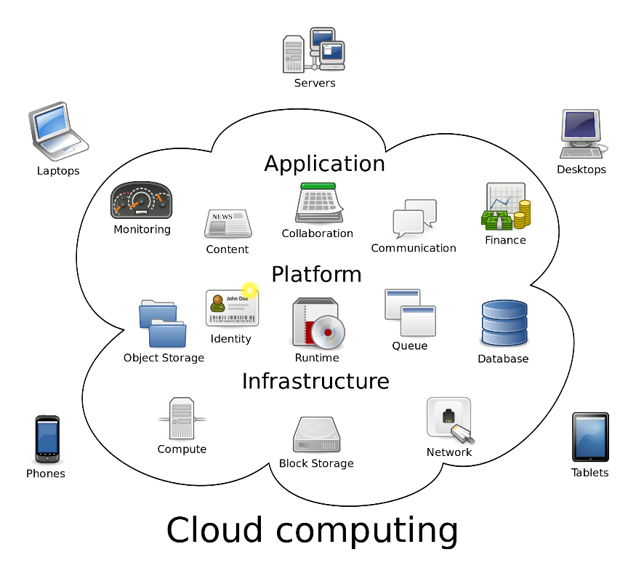
Cloud Computing – more than just someone else’s computer
Notes:
https://en.wikipedia.org/wiki/Cloud_computing#/media/File:Cloud_computing.svg
Remember, there is no such thing as the cloud when you are talking to IT professionals.
https://www.technologyreview.com/s/425970/who-coined-cloud-computing/
https://en.wikipedia.org/wiki/Cloud_computing
http://www.zdnet.com/article/stop-saying-the-cloud-is-just-someone-elses-computer-because-its-not/
Mary Branscombe, July 12, 2016, ZDnet:
The cloud is more than just someone else's computer accessible over the Internet. It is a high availability, “hyperscale, automated computer farm run by someone who's better at automation and security than you, and can buy electricity and servers and network connectivity more cheaply than you ”
“This is software-defined computing that's a step beyond hardware virtualisation; the CPU that runs the computation is a fungible resource that's allocated by software, at whatever level of abstraction you want. If you want a server to run your VM, you can have that. If you want to run PHP, Node or .NET code without caring where or how it runs, you can do that. If you want to stream sensor data from IoT devices or index a website or do any other arbitrary computation, you don't need a server to do that -- you just need the compute power available to you over the Internet.”

Slide 19
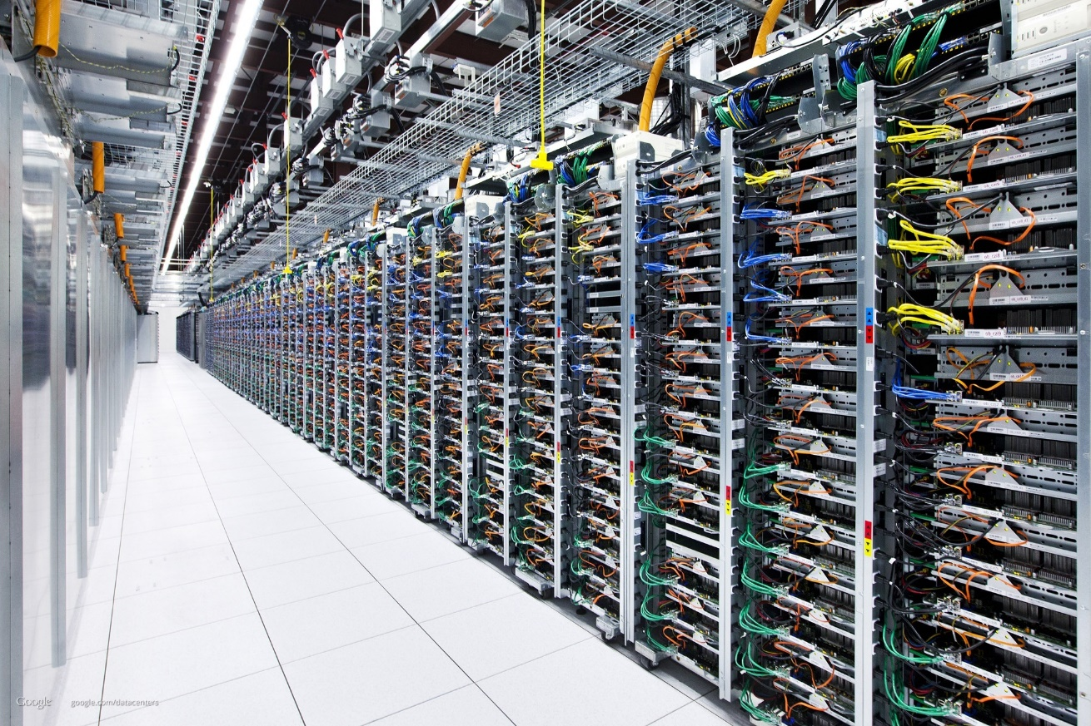

What a cloud looks like
Racks of servers with network cables.
Notes:
https://bpr.berkeley.edu/wp-content/uploads/2014/12/servers-770x513.jpg
See also server-farm by laboratorio linux (CC BY-NC-SA 2.0) https://flic.kr/p/SQVdB4
Fun fact: me.com is redirected to https://www.icloud.com/

Slide 20
Cloud Computing
the practice of using a network of remote servers on the Internet to store, manage, and process data, rather than a local server or a personal computer.
provides shared infrastructure, dev platform, or applications, on demand.
rapidly provisioned (and released) with minimal management effort. Low start up cost.
Notes:
Cheap, Fast, Good…you don’t have to pick just two anymore.
However, your data, your programming (IP), your web site, your business, and your livelihood is on someone else’s computer.

Slide 21
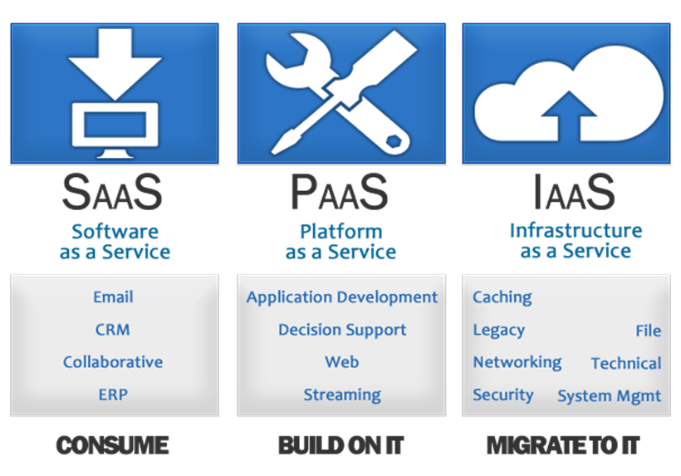
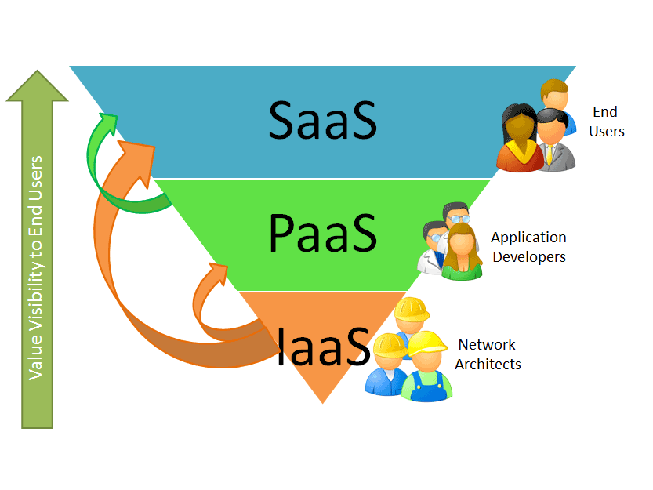
Cloud Computing Services
Notes:
This slide and the following slides are important.
Clients and colleagues will expect you to know the "cloud" has different levels of service.
Cloud Computing the practice of “using a network of remote servers on the Internet” to store, manage, and process data, rather than a local server or a personal computer.
provides “shared infrastructure, dev platform, or applications, on demand.”
rapidly provisioned (and released) with minimal management effort. Low start up cost.
However, your data, your programming (Intellectual Property), your web site, your business, and your livelihood is on someone else’s computer.
https://apprenda.com/library/paas/iaas-paas-saas-explained-compared/
https://www.cloudwards.net/understanding-cloud-terminology-what-does-iaas-paas-and-saas-mean/
https://www.salesforce.com/ca/saas/
https://getnerdio.com/blog/10-popular-software-service-examples/

Slide 22
Cloud Computing - IaaS
Infrastructure as a Service provides services such as networking, servers, storage space, and/or raw computing power to your client network.
High range of “scalability”
Amazon Web Services (AWS). Google Compute Engine (GCP)
your ISP provides your network connection.
Notes:
IaaS can eliminate capital expenditures companies traditionally make to buy their own on-premises hardware, IaaS can be a complete virtualized computer centre.
https://www.itworldcanada.com/article/head-start-helping-amazon-remain-the-top-public-cloud-provider-in-canada/402533
https://aws.amazon.com/directconnect/ <– uses "dark fiber"
With IaaS, a provider supplies the basic compute, storage and networking infrastructure along with the hypervisor (the virtualization layer). ICT admin users must then create virtual machines, install operating systems, support applications and data, and handle all of the configuration and management associated with those tasks. IaaS does not do much by itself, it is hardware/OS/networking you can use. IaaS is anything not on your premises but somehow connected to or supporting your system delivery at a low level.
https://cloud.google.com/
https://aws.amazon.com/
http://www.businessnewsdaily.com/5851-cloud-storage-solutions.html
http://searchcloudcomputing.techtarget.com/definition/Platform-as-a-Service-PaaS
Scaling Up or scalability is the ability to add capacity as your business grows or to deal with peaks in demand (concert tickets, Christmas buying season, weather and news events, US election night: the Canadian Immigration server (www.cic.gc.ca) crashed as the 2016 November USA election results were rolling in. The site went down about 10:30 p.m. ET that day with intermittent accessibility the next day or two until Americans got used to the idea that Donald Trump would be their new president.
Your ISP provides the networking infrastructure (Tier 3 connection to your house, physical nodes, routers, switches, network servers to Tier 2 network providers who then connect to Tier 1 backbones). For the most part, it is up to you how you use it. You hardly know your ISP is there except for your monthly billing. Infrastructure tends to be mostly invisible. Your ISP may provide other additional services but this is IaaS.
By contrast, IBM Capacity on Demand is a local version of this concept where you can turn on extra server capacity as you need it for your non-cloud infrastructure. It is literally extra CPUs built into the server on your premises which you pay a fee to activate.

Slide 23
Cloud Computing - PaaS
Platform as a Service provides the user with a development environment to create, run and test applications on different platforms without having to manage the platforms on the client network.
Windows Azure runs your ASP.NET applications
Red Hat OpenShift on Red Hat OpenStack Platform
Google App Engine
Notes:
With PaaS, a provider offers more of the application stack than IaaS providers, adding operating systems, middleware (such as databases) and other runtimes into the cloud environment. PaaS can eliminate capital expenditures companies traditionally make to buy their own on-premises hardware and software. Conceptually, PaaS is a Platform which runs on top of Infrastructure (Iaas).
A PaaS provider builds and supplies a resilient and optimized environment on which users (IT developers and administrators) can install applications and data sets. Developers focus on creating and running applications using the virtual PaaS. IT administrators do not have to construct and maintain the underlying infrastructure and services.
Many PaaS products are geared toward software development. These platforms offer compute and storage infrastructure, as well as text editing, version management, compiling and testing services that help developers create new software more quickly and efficiently. A PaaS product can also enable development teams to collaborate and work together, regardless of their physical location.

Slide 24
Cloud Computing - SaaS
Software as a Service provides the user with fully functioning web based applications with only a browser or small app. Don't think of it as just software!
SalesForce CRM – the original SaaS.
Google Apps, Microsoft Office 365, BigBlueButton
Audio/Visual Learning: https://www.lynda.com/Cloud-Computing-tutorials/Types-clouds/508619/546861-4.html
Notes:
Conceptually, SaaS runs on top of a Platform which runs on top of Infrastructure.
SaaS: There is software to interface with anything in the cloud (including IaaS and PaaS); don't think of SaaS as just software, think of SaaS as an application that provides sophisticated functionality to end users. "An application program is a computer program designed to perform a group of coordinated functions, tasks, or activities for the benefit of the user. Wikipedia" SaaS does it over the Internet through a browser (or mobile app equivalent) – the only thing on the client end is the User Interface.
Used for Personal software delivery: having your own MS-Office products without managing installation and maintenance on your own machine.
More and more, SaaS is cooperative processing where people collaborate on documents and information centrally rather than the email attachment nightmare of distribution, version control, and amalgamation of revisions from individual documents.
Your ISP provides email –SaaS -- @theirDomain.ca to keep you as a customer. You could run your own email server with a permanent IP address but why bother?…unless you are Hillary Clinton and don’t trust the U.S. gov servers and don’t mind losing an election.
Office 365 Delve, Google Apps.
https://support.office.com/en-us/delve
Microsoft Office 365 is a combined application provided by Microsoft consisting of Microsoft Office Online (for Windows and OS X), Exchange (email), SharePoint (file repository/sharing), and storage space on OneDrive.

Slide 25
File Sharing
Technology is something that upsets the ecology of space and time, even human relationships.
When you move bits instead of atoms, things change.
File Sharing is an example of that.
Notes:
Technology is something invented after you were born.
Before that, technology was part of the ecosystem, part of reality, it was already there…like oxygen, it was something you breathed in. New technology is something you adapt to.

Slide 26
Peer to Peer and Blockchain need networks
A peer-to-peer (P2P) network is two or more systems directly connected and sharing resources without using a separate server computer.
Advantages include low cost, easy to install, and no need for skilled staff or expensive servers
Disadvantages include difficulty of administration, issues of security + trust, performance, scalability, reliability
Notes:
P2P is Decentralized computing. It is also the architecture of networks themselves. There is no “boss”, just organizational cooperation on standards.
Disadvantages: there is no central authority to arbitrate disputes, balancing open cooperation (peering) with individual security is hard. Performance & reliability: if too many peers go offline, the overall P2P system will no longer work as well, e.g. bit torrent file sharing.
If all the peers must work cooperatively, scalability becomes an N-squared problem: every peer must talk to every other peer; with N peers, there are N-squared conversations.
Before Bitcoin, to use digital money, we needed a trusted third-party to keep a ledger of how much each of us has and owes, e.g. banks and credit card companies.
With blockchain technology, a trusted third-party is not needed. Blockchain works on a distributed database that maintains a continuously-growing list of ordered records called blocks. Each block contains a timestamp and a link to a previous block.^{[6]} By design blockchains are inherently resistant to modification of the data — once recorded, the data in a block cannot be altered retroactively.
Through the use of a peer-to-peer network and a distributed timestamping server, a blockchain database is managed autonomously. It is a distributed trustless consensus of who has what.
Consensus: For me to send or receive money, I must recognize what’s presented to me really is money, and I must also know that everyone else will also recognize it as such. A medium of exchange is something we both agree as having the same value.
Distributed: the system of peers must ensure consistency, that is when a transfer is made using the information supplied by one of the nodes it must be correctly reflected in all other nodes. There is no single source of "truth", everyone shares (and can individually verify) the same truth.
Trustless: you cannot trust any one peer but you can trust all the peers together. Peers perform work required to create consensus for the entire network, keeping the network sufficiently large that circumventing it becomes very expensive: a malicious peer would need enough computing power to compete with the entire existing network of peer to override consensus.
https://keepingstock.net/explaining-blockchain-how-proof-of-work-enables-trustless-consensus-2abed27f0845
From https://hackernoon.com/blockchains-dont-scale-not-today-at-least-but-there-s-hope-2cb43946551a …
Why isn’t the blockchain scalable?
Currently, all blockchain consensus protocols (eg. Bitcoin, Ethereum, Ripple, Tendermint) have a challenging limitation: every fully participating node in the network must process every transaction. Recall that blockchains have one inherent critical characteristic — “decentralization” — which means that every single node on the network processes every transaction and maintains a copy of the entire state. While a decentralization consensus mechanism offers some critical benefits, such as fault tolerance, a strong guarantee of security, political neutrality, and authenticity, it comes at the cost of scalability. The number of transactions the blockchain can process can never exceed that of a single node that is participating in the network. In fact, the blockchain actually gets weaker as more nodes are added to its network because of the inter-node latency that logarithmically increases with every additional node. In a traditional database system, the solution to scalability is to add more servers (i.e. compute power) to handle the added transactions. In the decentralized blockchain world where every node needs to process and validate every transaction, it would require us to add more compute to every node for the network to get faster. Having no control over every public node in the network leaves us in a pickle.
See (www.computerworld.com/article/2588287/networking/peer-to-peer-network.html)

Slide 27
File Sharing
File Sharing is the practice of or ability to transmit files from one computer to another over a network or the Internet.
File sharing is the public or private sharing of computer data on a network, so that multiple people can access the data to their level of access privilege.
File sharing makes collaboration easier, but is also used for the illegal distribution of music, movies, software, and pornography.
Notes:
Deliberate file sharing via FTP or torrents
Vs
Automatic or synchronized file sharing via cloud services such as OneDrive and Sync
See https://www.cloudwards.net/online-storage-vs-online-backup-whats-the-difference/

Slide 28
Is sharing music/video files illegal?
© Copyright in Canada :
Bill C-11, the Copyright Modernization Act, allows for time shifting, format shifting, and backup copies as long as no digital locks are involved.
Notes:
Canada has charged a levy (AKA tariff) on "blank audio recording media“, effectively blank CDs since 1997 (0.29/disc) “Part VIII of the Copyright Act allows consumers to copy recorded music for their own personal use. In exchange, the private copying levy was created to compensate music rights holders for private copies made of their music. ” http://www.cpcc.ca/en/ http://www.cpcc.ca/en/frequently-asked-questions
Music players such as iPods and memory cards do not qualify as an "audio recording medium".
The levy is collected regardless of the purchaser's end use of the media. https://en.wikipedia.org/wiki/Private_copying_levy#Canada
The IT industry made major contributions to the music industry when CDs were a common backup and distribution medium for files.
https://en.wikipedia.org/wiki/Copyright_Modernization_Act
http://www.barrysookman.com/2012/11/07/change-and-the-copyright-modernization-act/
http://www.barrysookman.com/2011/10/03/some-observations-on-bill-c-11-the-copyright-modernization-act/
http://www.huffingtonpost.ca/2015/01/08/michael-geist-copyright-modernization-act_n_6436584.html
http://business.financialpost.com/fp-tech-desk/pirates-in-your-neighbourhood-how-new-online-copyright-infringement-laws-are-affecting-canadians-one-year-later?__lsa=181b-aac5

Slide 29
Notes

Slide 30
Client-Server Model of Computer Networks
The client–server model is a distributed application structure that shares work between two cooperative & independent programs. A server provides a resource or service, a client requests and does further processing. (https://en.wikipedia.org/wiki/Client–server_model)
FTP clients, Outlook or Thunderbird local email clients
Advantages include fault tolerance (client runs when server is n/a), load balancing.
Disadvantages are higher cost & skilled staff to architect and maintain both client and server software.
Notes:
Student Center is truly a client application, it just looks like a browser application. Woe is anyone who uses the back button. It is a self-contained JavaScript application that is run inside a browser but it is not a web app not does it use web pages.
A locally installed Outlook application is sophisticated standalone client software that uses a server for sending/receiving email. It mirrors the email content on the client to match the server. The local application offers fast and sophisticated user interface and searching capabilities. This is distinctly different from Outlook running in a browser as part of Office 365 where nothing is stored on the client side; the server offers slow and slightly less sophisticated user interface and searching capabilities delivered through a browser.
A native app on a mobile device is a client application that interacts with a server (often an advertising and “in-app purchase” server).
fault tolerance, load balancing, and high security are usually thought of as server side issues generally dealt with by various forms of redundancy.
Smart clients can also contribute to these aspects…next slide.

Slide 31
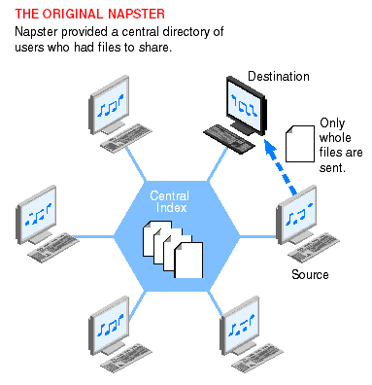
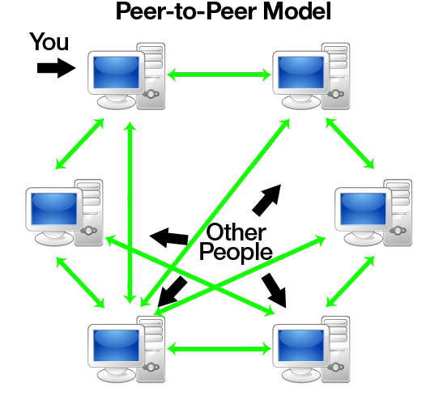
File Sharing: Napster vs BitTorrent
Notes:
Napster started 1999, based on P2P. Its “central database stored the location of all music files” (MP3). Individuals could request a song and the server would provide the location. “Peer computer would download the file directly to the requester.” Napster completely disrupted the music distribution business very quickly. As a result, it was sued by performers and other larger organizations. Napster ceased operations in 2002. It was reopened as an online store in 2006. Was bought by Best Buy in 2008 and sold to Rhapsody in 2011.
BitTorrent, since 2001, is a decentralized Peer-to-peer (P2P) architecture where portions of files can be exchanged. Several factors contributed to the widespread adoption and facilitation of peer-to-peer file sharing. These included increasing Internet bandwidth, the widespread digitization of physical media, and the increasing capabilities of residential personal computers.
P2P is not just for illegal file sharing, cracks, and warez. Microsoft uses it for Update distribution (Windows 10) and online playing games (the mmorpg Skyforge^{[2]}) use it as their content distribution network for downloading large amounts of data without incurring the dramatic costs for bandwidth inherent when providing just a single source.
In 2007, P2P file sharing accounted for 37% of Internet traffic. Today, that portion is streaming…mostly Netflix.
http://www.slideshare.net/srijish/p2p-principle-architecture-and-challenges-presentation
http://www.torrentkittytorrentkitty.com/history-of-torrent/
https://www.lifewire.com/free-p2p-file-sharing-software-programs-818053
https://en.wikipedia.org/wiki/Peer-to-peer_file_sharing

Slide 32
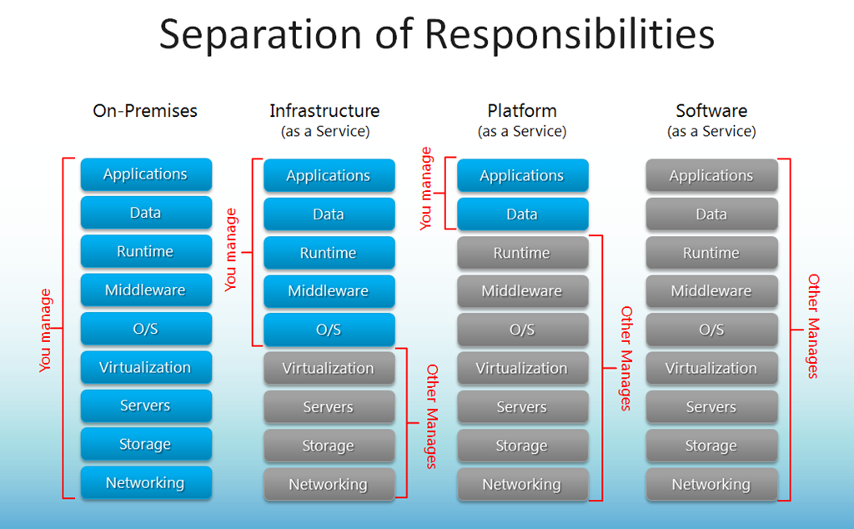
Cloud Computing

